Slide 1

AI & ML Laboratory Project on Diabetic Retinopathy Detection
B . Sathwika Reddy 2203A51465
G . Indu Reddy 2203A51476
B . Triveni 2203A51464
P . Sindhuja Reddy 2203A51506
Batch 20
Section : G
- UNDER THE GUIDANCE OF
Dr .Soumik Podder
School of Computer Science & Artificial Intelligence
SR University
2024
/

Slide 2
Plan of Talk
ABSTRACT
INTRODUCTION
PROPOSED SOLUTION
FLOW CHART
RESULT AND DISCUSSION
CONCLUSION

Slide 3
ABSTRACT
Why is this project ?
Diabetic retinopathy detection in artificial intelligence and machine learning (AIML) is an important application of technology in healthcare. Diabetic retinopathy is a complication of diabetes that affects the eyes, potentially leading to blindness if not detected and treated early. AIML techniques offer promising avenues for improving the early detection and management of diabetic retinopathy for several reasons:
Early Detection
Accuracy
Scalability
Efficiency

Slide 4
Key Features of the project
Here are the key features of a project on diabetic retinopathy detection using AIML broken down into sub-points:
Data Collection and Pre-processing
Feature Extraction
Model Development
Model Evaluation
Interpretability and Explainability
Integration with Clinical Workflow
Deployment and Validation
Continual Improvement and Maintenance
These features collectively contribute to the development of an effective and clinically impactful diabetic retinopathy detection system using AIML techniques

Slide 5
Is it helpful for real life application?
Yes, diabetic retinopathy detection using artificial intelligence and machine learning (AIML) holds significant promise for real-life applications in healthcare.
AIML algorithms can analyze retinal images to detect signs of diabetic retinopathy at an early stage, even before symptoms appear.
IML-based systems can be deployed in various healthcare settings, including primary care clinics, community health centers, and even remote areas with limited access to ophthalmologists.

Slide 6
INTRODUCTION
Diabetic retinopathy is a common complication of diabetes that can lead to vision loss if not detected and treated early.
Artificial intelligence and machine learning (AIML) techniques offer promising solutions for automated detection of diabetic retinopathy.
Diabetic retinopathy, a common complication of diabetes, can cause vision loss if not detected early.
Artificial intelligence and machine learning (AIML) offer promising solutions for automated detection.

Slide 7
Objective: Develop a diabetic retinopathy detection system using AIML algorithms.
Aim: Explore efficacy of different machine learning approaches in detection.
Potential Impact: Early detection can reduce vision loss, improve healthcare accessibility.
Machine learning algorithms like Random Forest, Decision Trees, and SVMs excel in pattern recognition tasks

Slide 8
PROPOSED Solution
Proposed Solution for Diabetic Retinopathy Detection using Random Forest, Decision Tree, and SVM ,kneighbours classifiers, logistic relation:
Utilize a diverse dataset of retinal images containing both normal and diabetic retinopathy cases.
Preprocess the images to normalize, resize, and augment the dataset for improved model performance.
Extract relevant features from retinal images using Random Forest, Decision Tree, and SVM algorithms.
Train separate models based on each algorithm to classify retinal images into diabetic retinopathy stages.
Evaluate the performance of each model using metrics such as accuracy, sensitivity, specificity, and AUC-ROC.

Slide 9
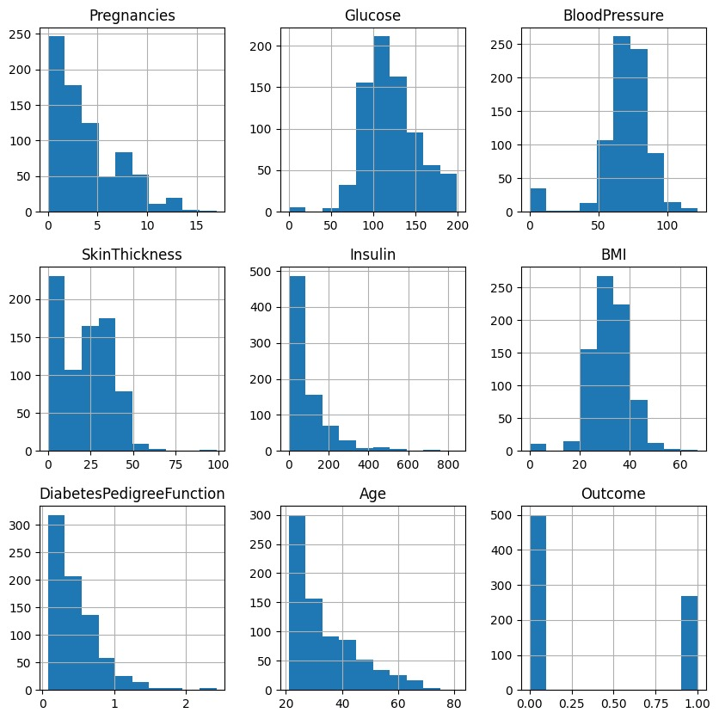
Results and Discussion

Slide 10
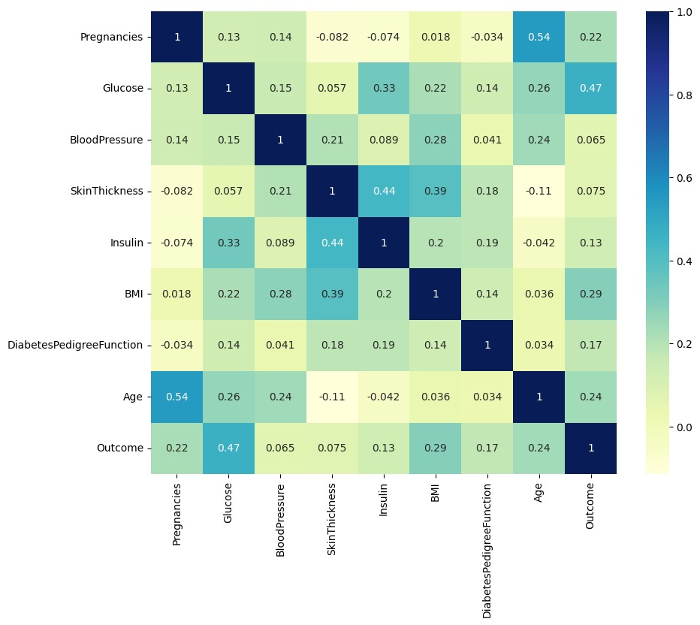
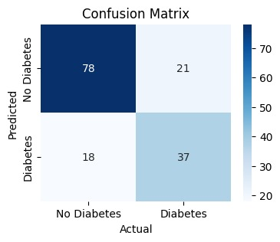

Slide 11
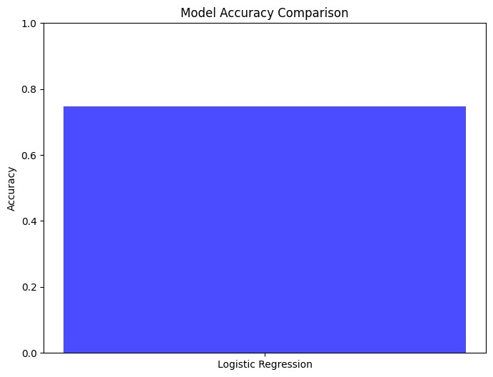
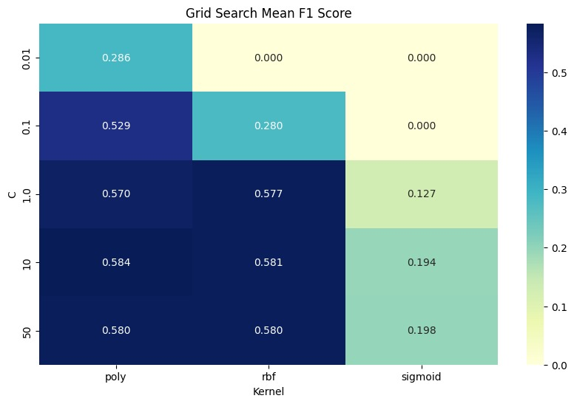

Slide 12
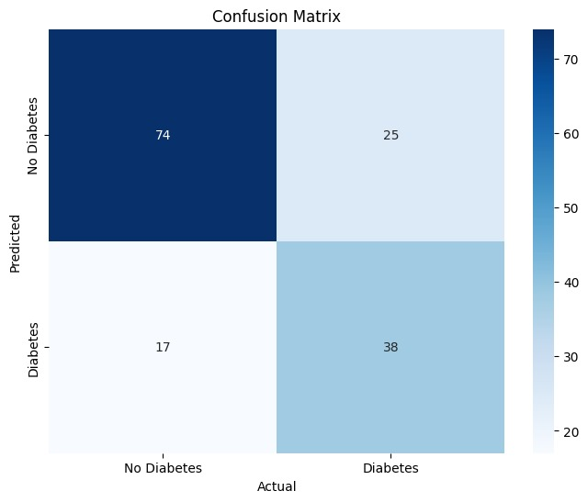
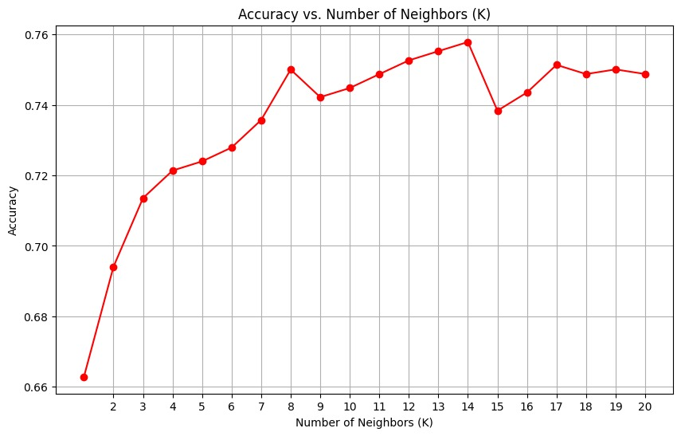

Slide 13
Table 1:
Comparative study of performance:
Model name
S.no
Accuracy
F1 Score
Recall
Precision
Avg
0
1 0 1 0 1
79% 76% 80.85 0.68 0.89 0.62 0.81 0.62
1
SVM
2 LR 75% 73% 0.80 0.65 0.79 0.67 0.81 0.64
3 KNN 66% 64% 0.73 0.55 0.71 0.58 0.75 0.52
4 RF 77% 75% 0.83 0.67 0.84 0.65 0.81 0.65

Slide 14
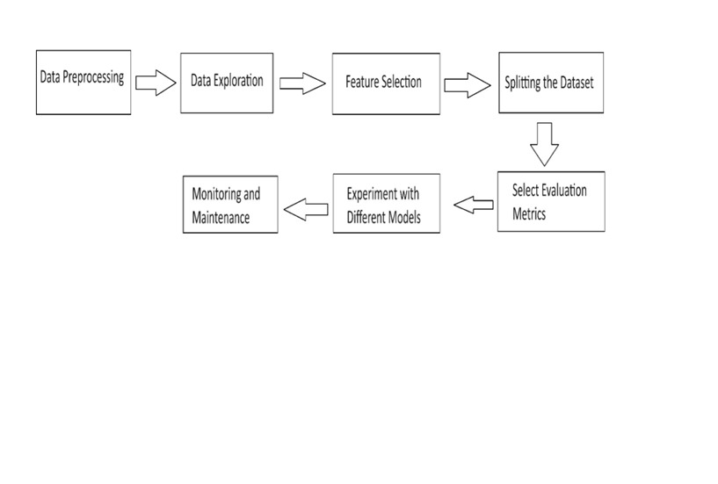
FLOW CHART

Slide 15
CONCLUSION
SVM exhibits particularly high accuracy and robustness, making it a strong candidate for real-world deployment.
Random Forest and Decision Tree models also perform well and could be considered in contexts where interpretability is crucial.
The findings underscore the importance of leveraging diverse machine learning approaches to address complex healthcare challenges like diabetic retinopathy.
Future research could focus on enhancing model interpretability, scalability, and integration into clinical workflows for widespread adoption and impact.

Slide 16
GIT HUB Link and LINKDIN LINK
https://github.com/2203A51506/AIML-BATCH-20/blob/main/diabetic_rethinopathy_detection.ipynb

Slide 17
References
https://www.kaggle.com/datasets/akshaydattatraykhare/diabetes-dataset

